Slide 1

David M. Kroenke and David J. Auer Database Processing: Fundamentals, Design, and Implementation
Chapter Six:
Transforming Data Models into Database Designs

Slide 2
Chapter Objectives
To understand how to transform data models into database designs
To be able to identify primary keys and understand when to use a surrogate key
To understand the use of referential integrity constraints
To understand the use of referential integrity actions
To be able to represent ID-dependent, 1:1, 1:N, and N:M relationships as tables
To be able to represent weak entities as tables

Slide 3
Chapter Objectives
To be able to represent supertypes/subtypes as tables
To be able to represent recursive relationships as tables
To be able to represent ternary relationships as tables
To be able to implement referential integrity actions required by minimum cardinalities

Slide 4
The Database Design
A data model is transformed into a database design.
A database design is a set of database specifications that can actually be implemented in a specific DBMS product.
Therefore, a database design for a database in Microsoft SQL Server 2014 will differ from a database design for the same database in Oracle Database or MySQL 5.6.

Slide 5
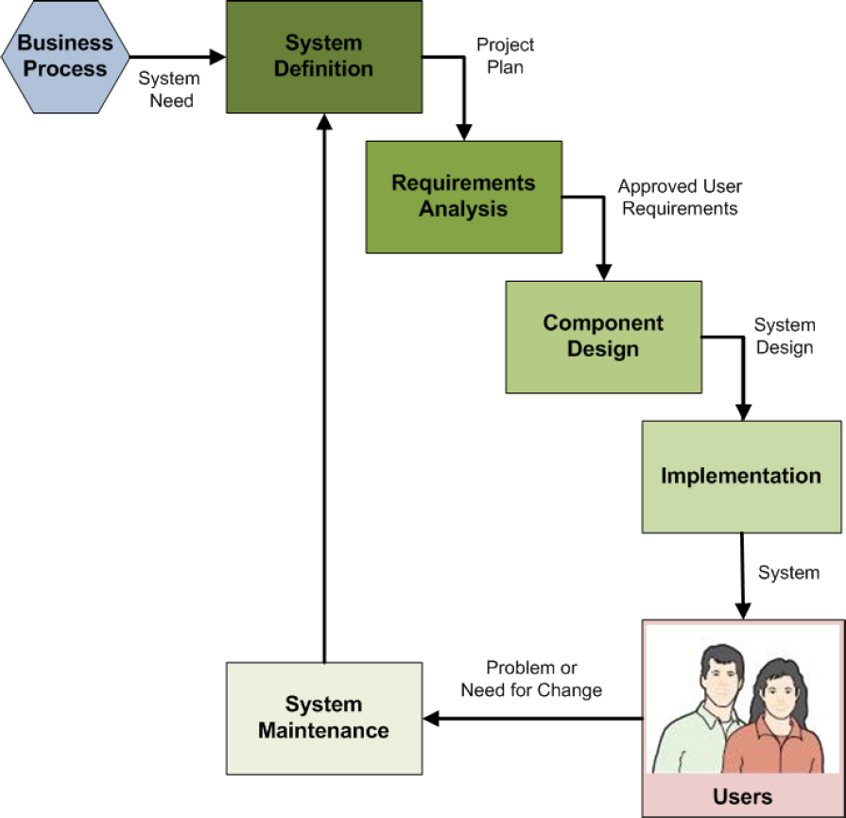
Database Design in the SDLC
The systems development life cycle (SDLC) as discussed in Appendix B
Database design occurs in the component design step of the SDLC
The final database design is part of the final system design

Slide 6
Database Design = Logical Design + Some Physical Design
Books on systems analysis and design often identify three design stages:
Conceptual design (conceptual schema)
Logical design (logical schema)
Physical design (physical schema)
The database design we are discussing is equivalent to the logical design plus some physical design elements (data types) as defined in these books.

Slide 7
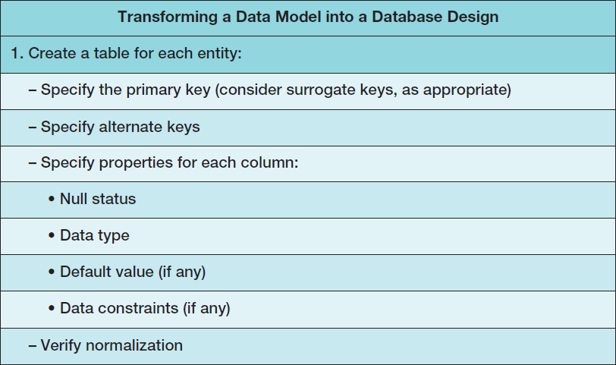
Steps for Transforming a Data Model into a Database Design I

Slide 8
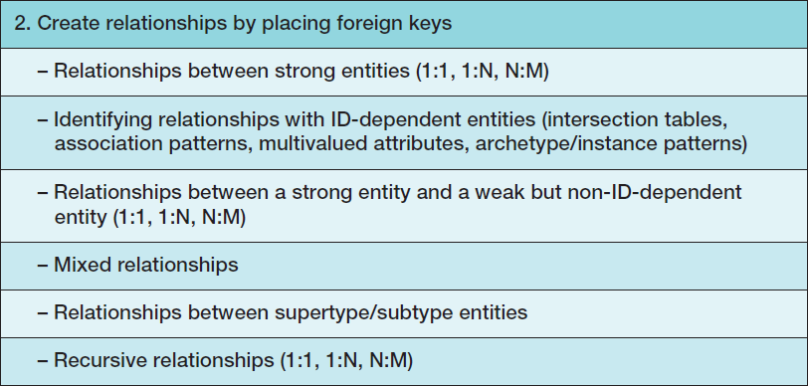
Steps for Transforming a Data Model into a Database Design II

Slide 9
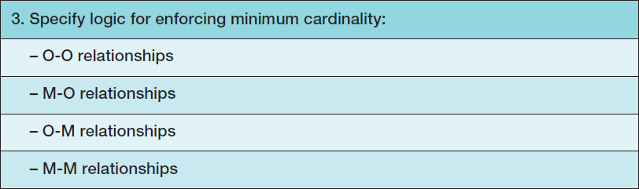
Steps for Transforming a Data Model into a Database Design III

Slide 10

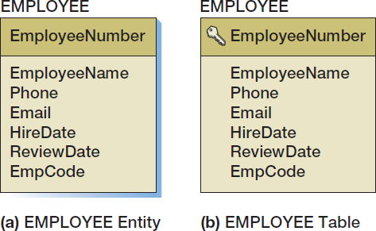
Create a Table for Each Entity
Primary key is designated by the key symbol
Note shadowless table

Slide 11
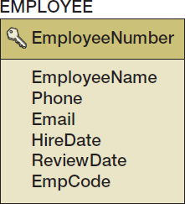
Select the Primary Key
The ideal primary key is short, numeric, and fixed.
Surrogate keys meet the ideal, but have no meaning to users.
Notes:
Some database designers take the position that, for consistency, if one table has a surrogate key, all of the tables in the database should have a surrogate key. Others think that such a policy is too rigid; after all, there are good data keys, such as ProductSKU (which would use SKU codes discussed in Chapter 2). If such a key exists, it should be used instead of a surrogate key. Your organization may have standards on this issue that you should follow.
Be aware that DBMS products vary in their support for surrogate keys.
Microsoft Access 2013, Microsoft SQL Server 2014, and MySQL 5.6 provide them.
Microsoft SQL Server 2014 allows the designer to pick the starting value and increment of the key, and MySQL 5.6 allows the designer to pick the starting value.
Oracle’s Oracle Database, however, does not provide direct support for surrogate keys, but you can obtain the essence of them in a rather backhanded way, as discussed in Chapter 10B.
In this book, we use surrogate keys unless there is some strong reason not to. In addition to the advantages described here, the fact that they are fixed simplifies the enforcement of minimum cardinality, as you will learn in the last section of this chapter.

Slide 12
Specify Candidate (Alternate) Keys
The terms candidate key and alternate key are synonymous.
Candidate keys are alternate identifiers of unique rows in a table.
Will use AKn.m notation, where n is the number of the alternate key, and m is the column number in that alternate key.

Slide 13
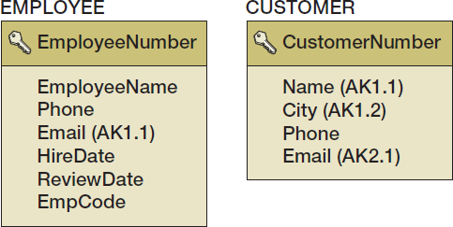
Specify Candidate (Alternate) Keys

Slide 14
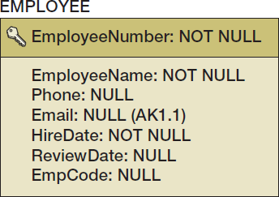
Specify Column Properties: Null Status
Null status indicates whether or not the value of the column can be NULL.
Notes:
The EMPLOYEE table contains a subtlety.
EmployeeNumber, the primary key, is marked NOT NULL, but Email, the alternate key, is marked NULL.
It makes sense that EmployeeNumber should not be allowed to be null. If it were, and if more than one row had a null value, then EmployeeNumber would not identify a unique row. Why, however, if (1) an alternate key is a candidate key and (2) a candidate key must uniquely identify a row, should Email be allowed to have null values?
The answer is that alternate keys often are used just to ensure uniqueness. Marking Email as a (possibly null) alternate key means that Email need not have a value, but, if it has one, then that value will be unique and different from all other values of Email in the EMPLOYEE table.
This answer is dissatisfying because it means that alternate keys used in this manner are not truly alternate primary keys, and thus neither are they true candidate keys!
Alas, that’s the way it is. Just know that primary keys can never be null but that alternate keys can be.

Slide 15
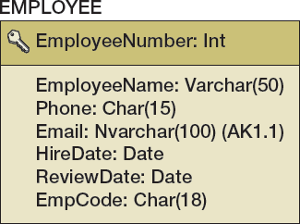
Specify Column Properties: Data Type
Generic data types:
Char(n), Nchar(n)
Varchar(n), Nvarchar(n)
Date
Time
Integer
Decimal(m,n)
Numeric(m,n)
Money(m,n)

Slide 16
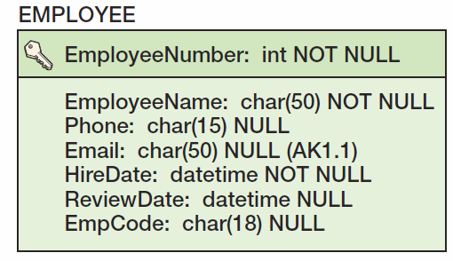
Specify Column Properties: Data Type + Null Status

Slide 17
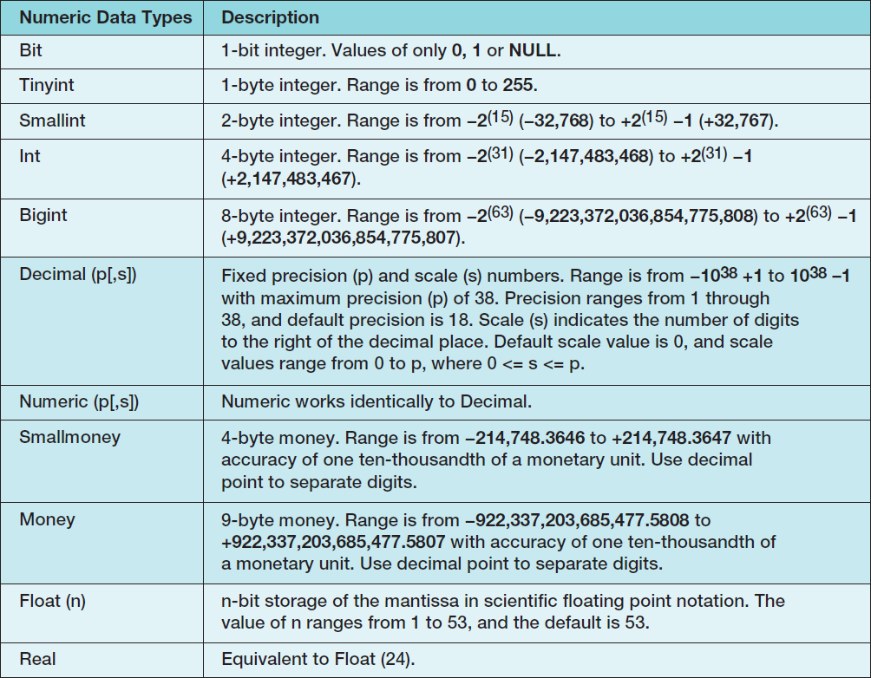
Specify Column Properties: SQL Server 2014 Data Types I

Slide 18
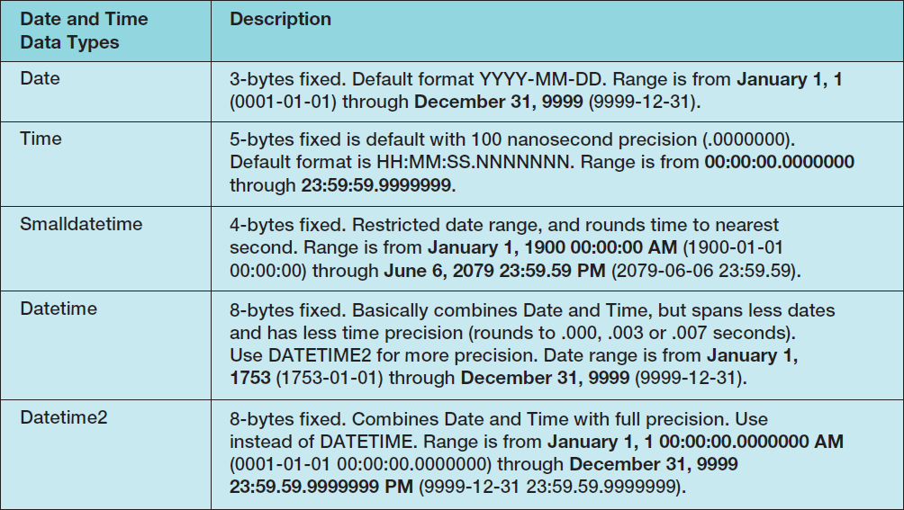
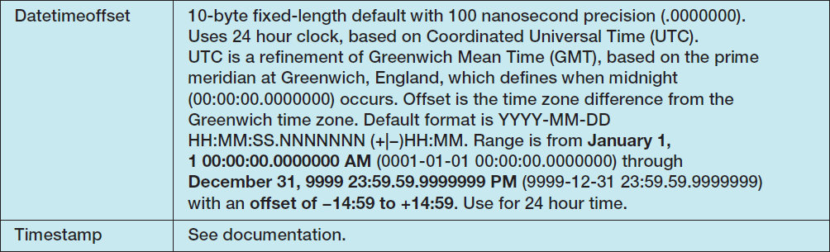
Specify Column Properties: SQL Server 2014 Data Types II

Slide 19
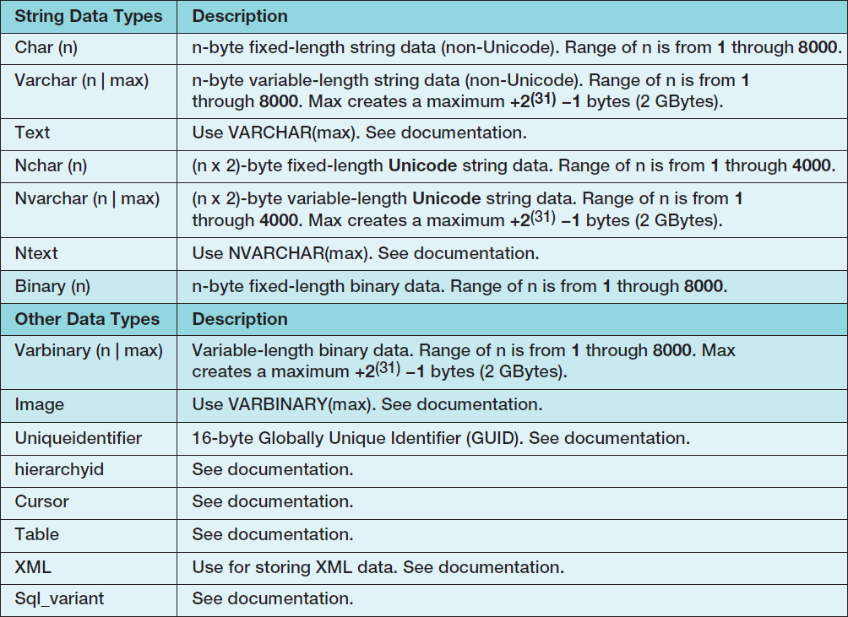
Specify Column Properties: SQL Server 2014 Data Types III

Slide 20
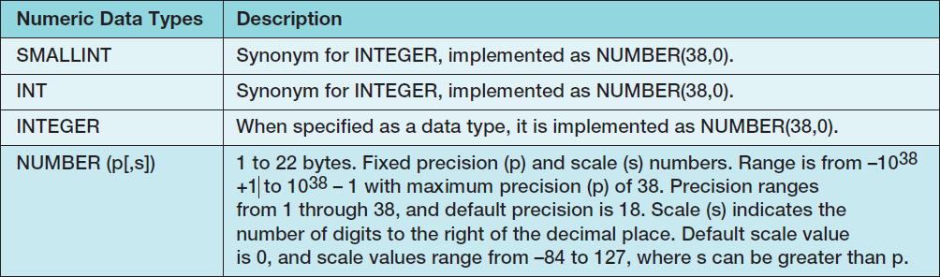
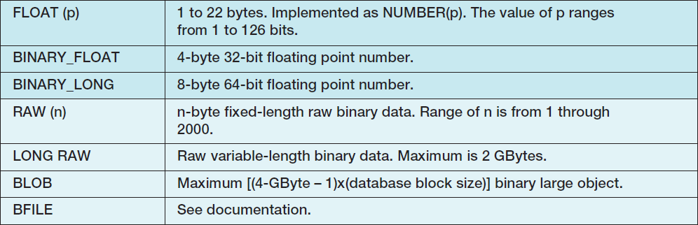
Specify Column Properties: Oracle Database Data Types I

Slide 21
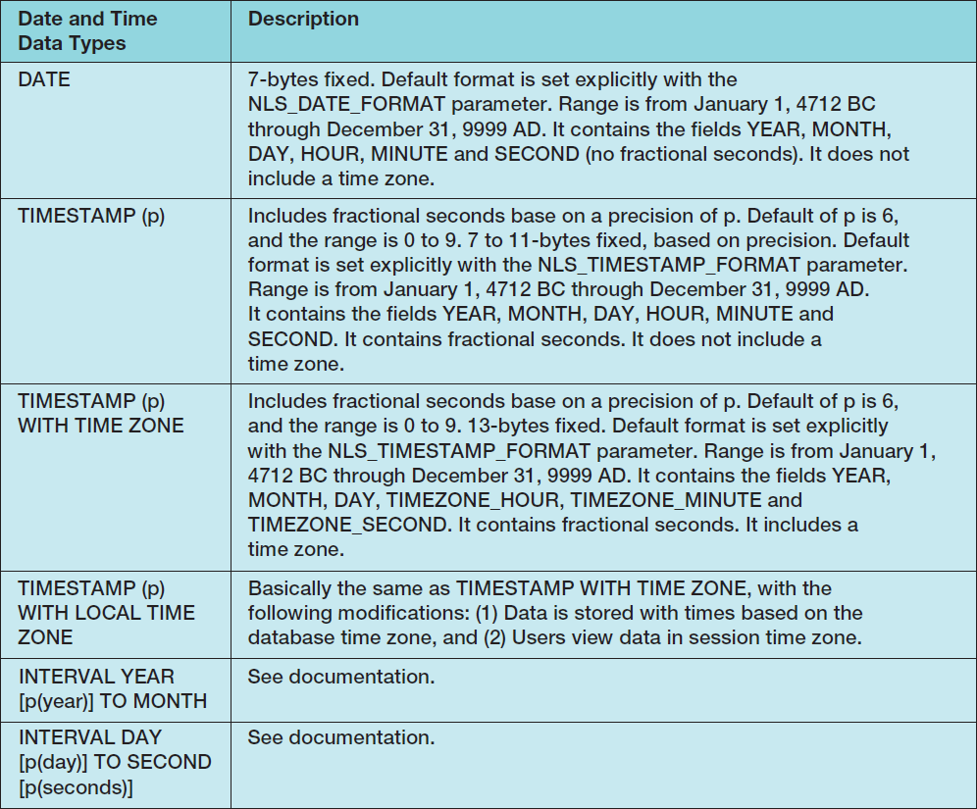
Specify Column Properties: Oracle Database Data Types II

Slide 22
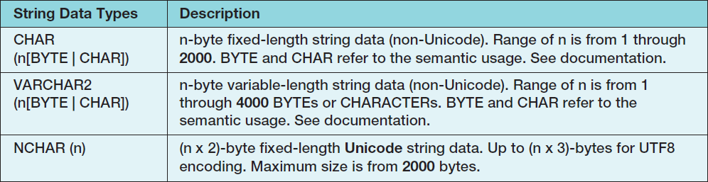
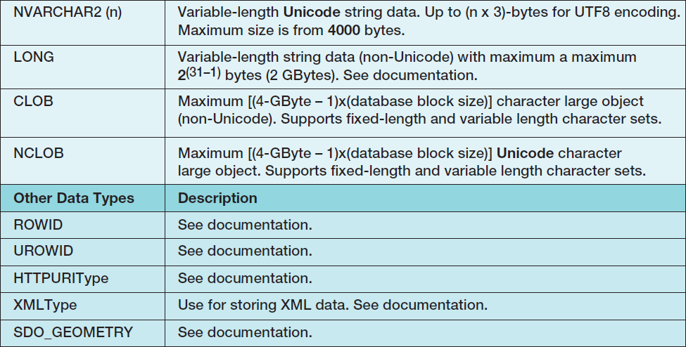
Specify Column Properties: Oracle Database Data Types III

Slide 23
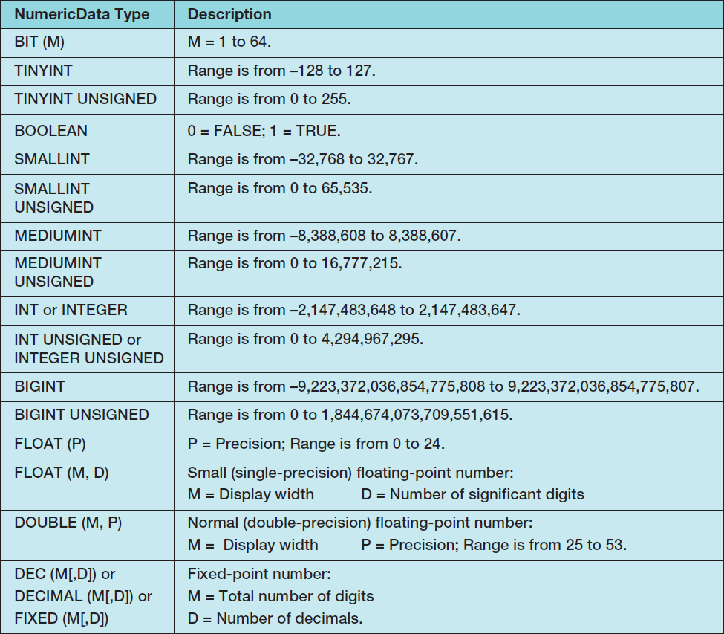
Specify Column Properties: MySQL 5.6 Data Types I

Slide 24
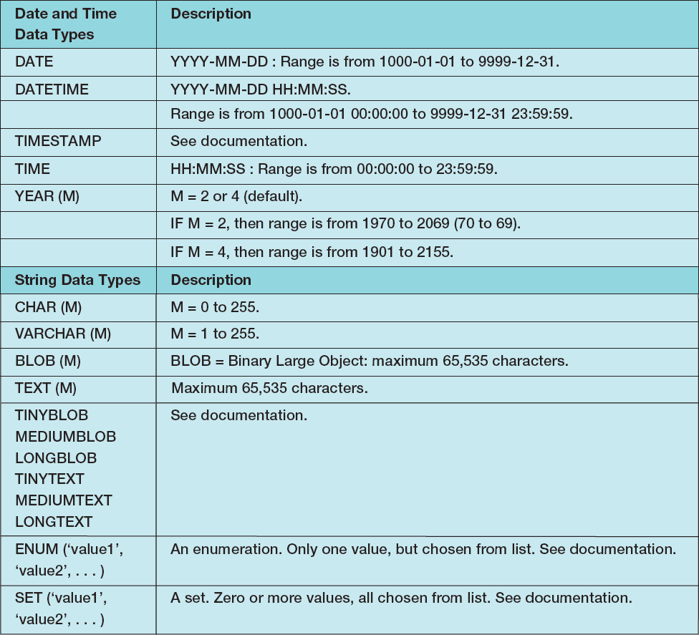
Specify Column Properties: MySQL 5.6 Data Types II

Slide 25
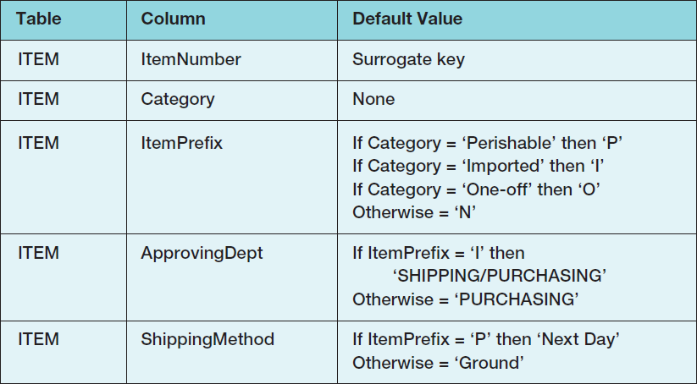
Specify Column Properties: Default Value
A default value is the value supplied by the DBMS when a new row is created.

Slide 26
Specify Column Properties: Data Constraints
Data constraints are limitations on data values:
Domain constraint—column values must be in a given set of specific values.
Range constraint—column values must be within a given range of values.
Intrarelation constraint—column values are limited by comparison to values in other columns in the same table.
Interrelation constraint—column values are limited by comparison to values in other columns in other tables (referential integrity constraints on foreign keys).

Slide 27
Verify Normalization
The tables should be normalized based on the data model.
Verify that all tables are in either:
BCNF
4NF

Slide 28
Create Relationships: 1:1 Strong Entity Relationships I
Place the primary key of one entity in the other entity as a foreign key.
Either design will work—no parent, no child
Minimum cardinality considerations may be important.
O-M will require a different design than M-O.
One design will be very preferable.

Slide 29
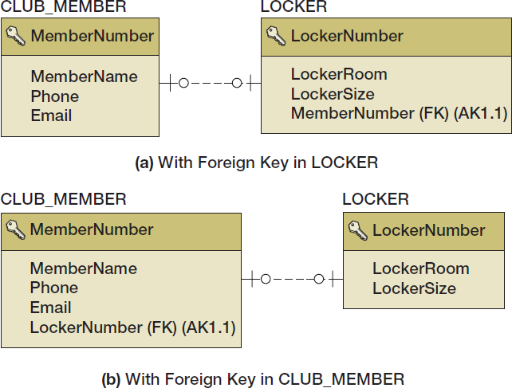
Create Relationships: 1:1 Strong Entity Relationships II

Slide 30
Create Relationships: 1:N Strong Entity Relationships I
Place the primary key of the table on the one side of the relationship into the table on the many side of the relationship as the foreign key.
The one side is the parent table and the many side is the child table, so “place the key of the parent in the child.”

Slide 31
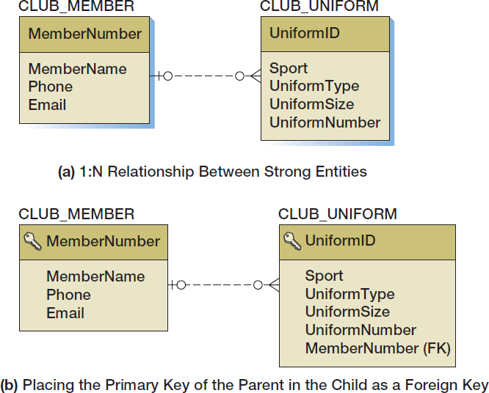
Create Relationships: 1:N Strong Entity Relationships II

Slide 32
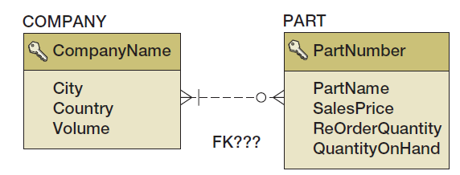
Create Relationships: N:M Strong Entity Relationships I
In an N:M strong entity relationship there is no place for the foreign key in either table.
A COMPANY may supply many PARTs.
A PART may be supplied by many COMPANYs.

Slide 33
Create Relationships: N:M Strong Entity Relationships II
The solution is to create an intersection table that stores data about the corresponding rows from each entity.
The intersection table consists only of the primary keys of each table which form a composite primary key.
Each table’s primary key becomes a foreign key linking back to that table.
COMPANY_PART_INT (CompanyName, PartNumber)
Notes:
While we use the term intersection table in this book, this table structure is known by many other names.
In fact, Wikipedia lists 11 alternate names, including intersection table, junction table, bridge table, and association table. While we reserve the term association table for an association relationship (as explained later in this chapter), your instructor may prefer one of the other terms for this table structure.
For more information, see the Wikipedia article Junction table at http://en.wikipedia.org/wiki/Junction_table .
The problem for the data models of N:M relationships between strong entities is that they have no direct representation. N:M relationships must always be decomposed into two 1:N relationships using an intersection table in the database design. This is why products like MySQL Workbench are unable to represent N:M relationships in a data model. These products force you to make the transformation to two 1:N relationships ahead of time, during modeling. As stated in Chapter 5, however, most data modelers consider this requirement to be a nuisance because it adds complexity to data modeling when the whole purpose of data modeling is to reduce complexity to the logical essentials.

Slide 34
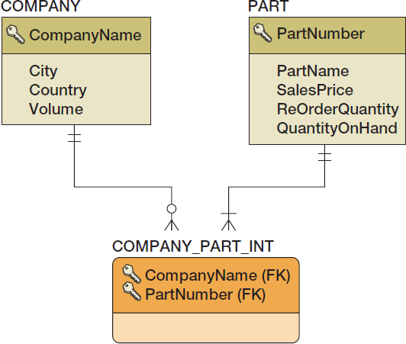
Create Relationships: N:M Strong Entity Relationships III
COMPANY_PART_INT (CompanyName, PartNumber)

Slide 35
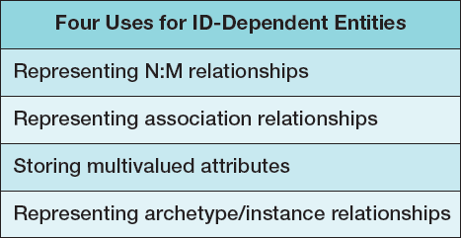
Relationships Using ID-Dependent Entities: Four Uses for ID-Dependent Entities

Slide 36
Relationships Using ID-Dependent Entities: Association Relationships I
An intersection table
Holds the relationships between two strong entities in an N:M relationship
Contains only the primary keys of the two entities:
As a composite primary key
As foreign keys
An association table
Has all the characteristics of an intersection table
PLUS it has one or more columns of attributes specific to the associations of the other two entities
Notes:
The table that represents the association entity looks very much like an intersection table; the only difference is the presence of the Price attribute.
Because of the attribute, the need for association tables, such as QUOTATION, will appear in user requirements. Somewhere there will be a form or a report that has the attribute Price.
However, the need for intersection tables never appears in the users’ world. Such tables are an artifact of the relational model, and no form, report, or other user requirement will indicate the need for one.
Intersection tables complicate the construction of applications. They must be processed to obtain related rows, but they never directly appear on a form or report.
In Microsoft Access, they are frustratingly difficult to mangle into the form and report design tools. You will see more about this in later chapters. In any case, for now understand the key difference between association and intersection tables: Association tables have user data, but intersection tables do not.

Slide 37
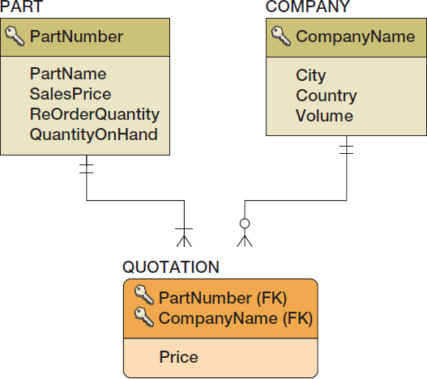
Relationships Using ID-Dependent Entities: Association Relationships II
QUOTATION (CompanyName, PartNumber, Price)

Slide 38
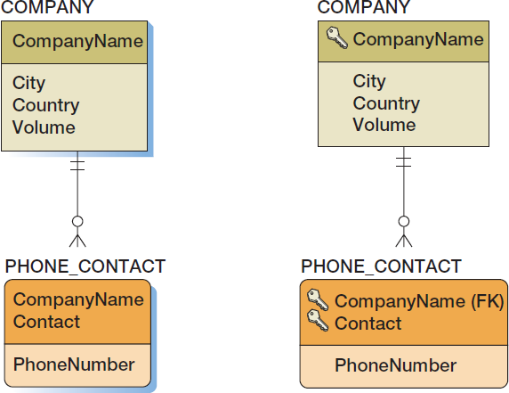
Relationships Using ID-Dependent Entities: Multivalued Attributes
As a data model
As a database design

Slide 39
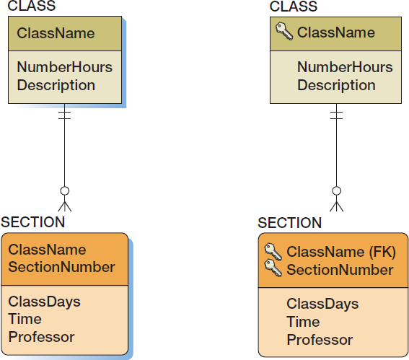
Relationships Using ID-Dependent Entities: Archetype/Instance Pattern
As a data model
As a database design

Slide 40
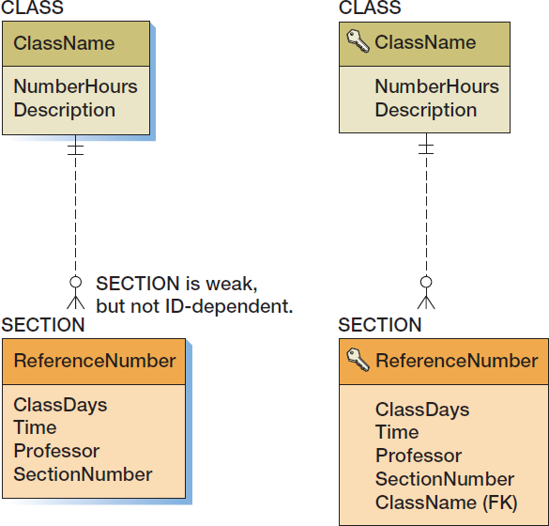
Relationships Using Weak Entities: Archetype/Instance Pattern
As a data model
As a database design

Slide 41
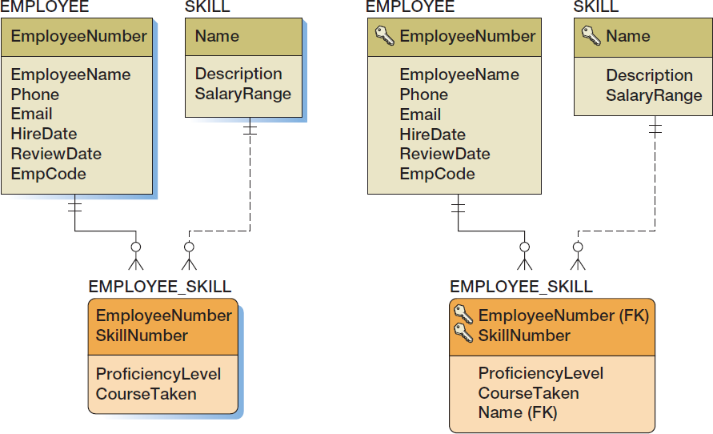
Mixed Entity Relationships
As a data model
As a database design

Slide 42
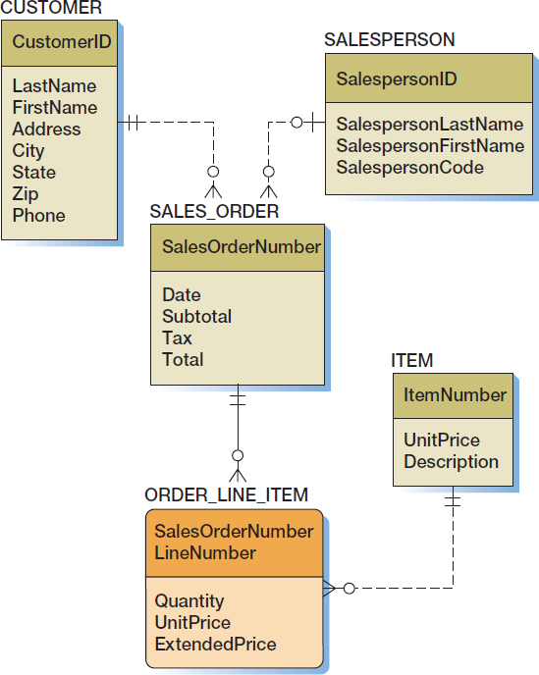
Mixed Entity Relationships: The SALES_ORDER Pattern I
As a data model

Slide 43
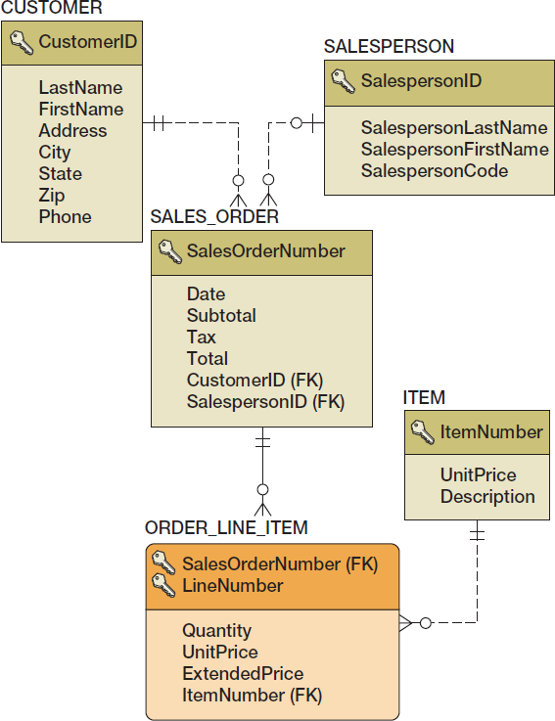
Mixed Entity Relationships: The SALES_ORDER Pattern II
As a database design

Slide 44
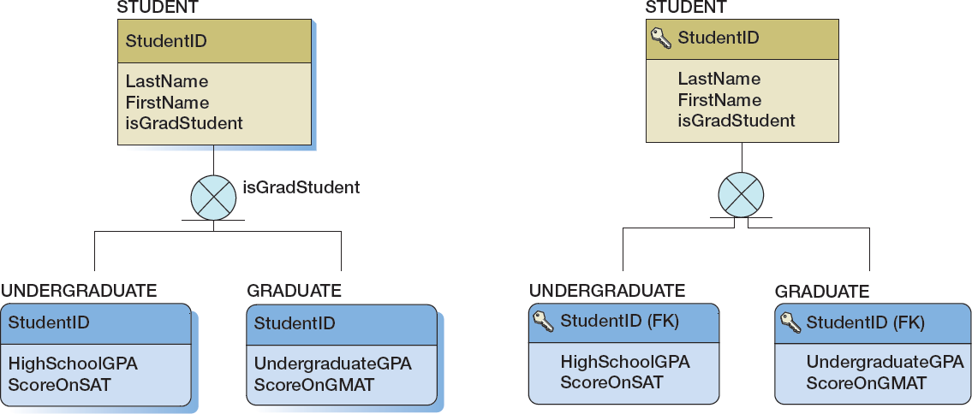
Subtype Relationships
As a data model
As a database design

Slide 45
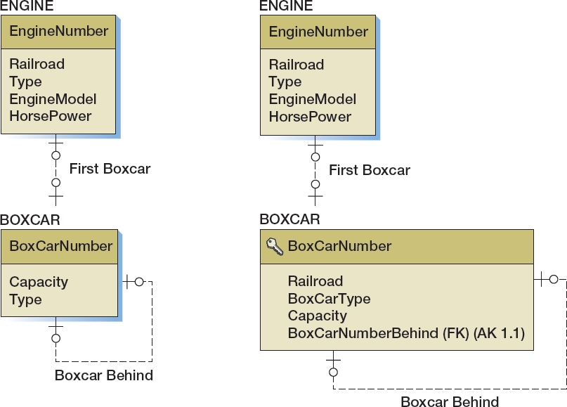
Recursive Relationships: 1:1 Recursive Relationships
As a data model
As a database design
Notes:
If you find the concept of recursive relationships confusing, try this trick.
Assume that you have two entities, BOXCAR_AHEAD and BOXCAR_BEHIND, each having the same attributes. Notice that there is a 1:1 relationship between these two entities.
Replace each entity with its table. Like all 1:1 strong entity relationships, you can place the key of either table as a foreign key in the other table.
For now, place the key of BOXCAR_BEHIND into BOXCAR_AHEAD.
Now realize that BOXCAR_BEHIND only duplicates data that reside in BOXCAR_AHEAD.
The data are unnecessary. So, discard BOXCAR_BEHIND and you will have the same design as shown here.

Slide 46
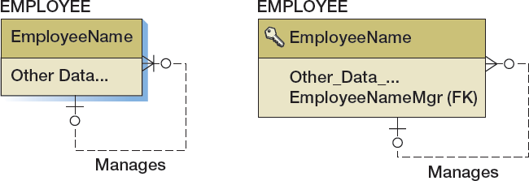
Recursive Relationships: 1:N Recursive Relationships
As a data model
As a database design

Slide 47
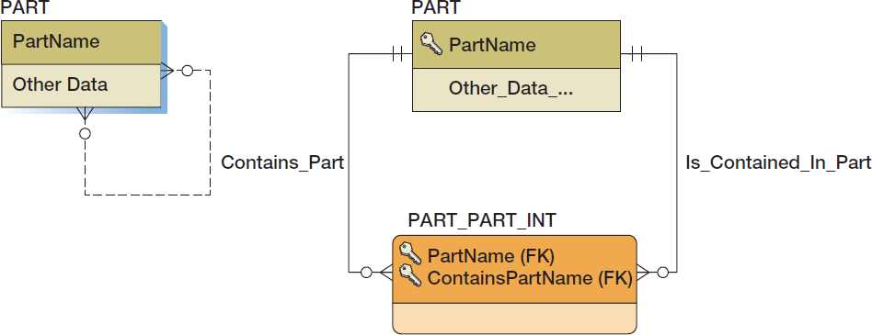
Recursive Relationships: N:M Recursive Relationships
As a
data model
As a database design

Slide 48
Representing Ternary and Higher-Order Relationships
Ternary and higher-order relationships may be constrained by the binary relationship that comprise them.
MUST constraint—requires that one entity must be combined with another entity in the ternary (or higher-order) relationship.
MUST NOT constraint—requires that certain combinations of two entities are not allowed to occur in the ternary (or higher-order) relationship.
MUST COVER constraint—a binary relationship specifies all combinations of two entities that must appear in the ternary (or higher-order) relationship.

Slide 49
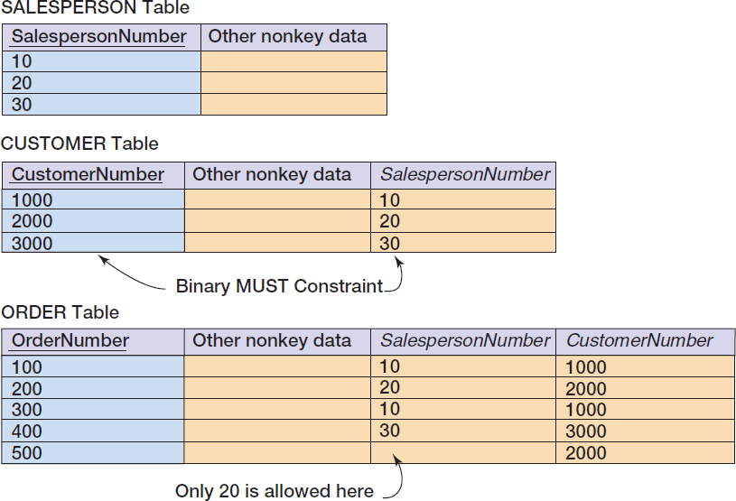
MUST Constraint

Slide 50
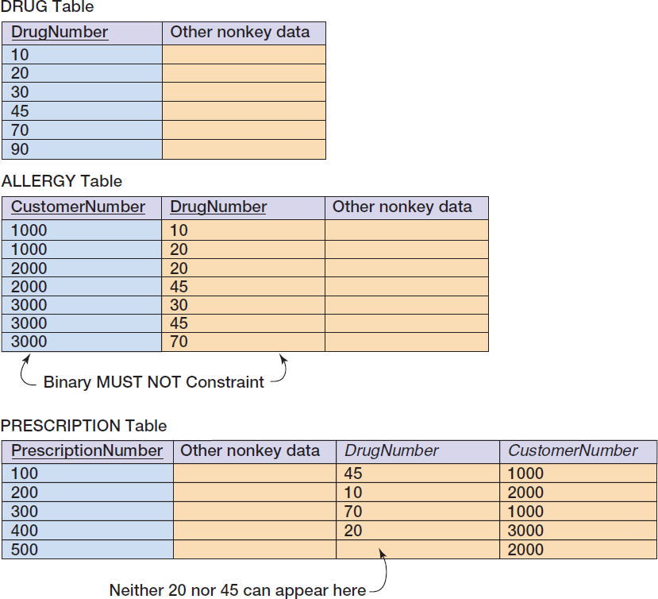
MUST NOT Constraint

Slide 51
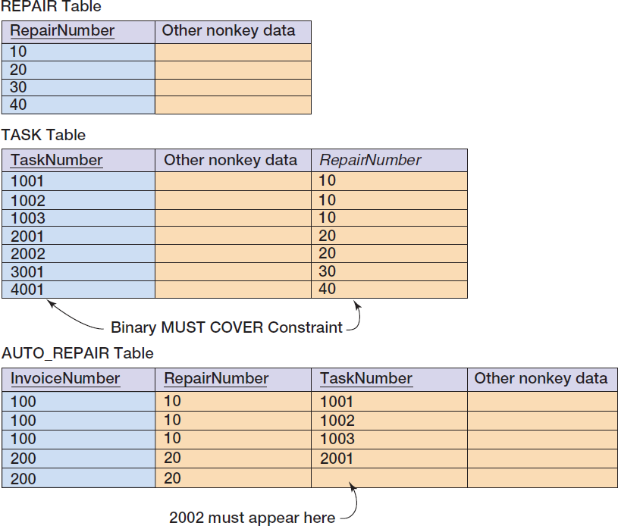
MUST COVER Constraint

Slide 52
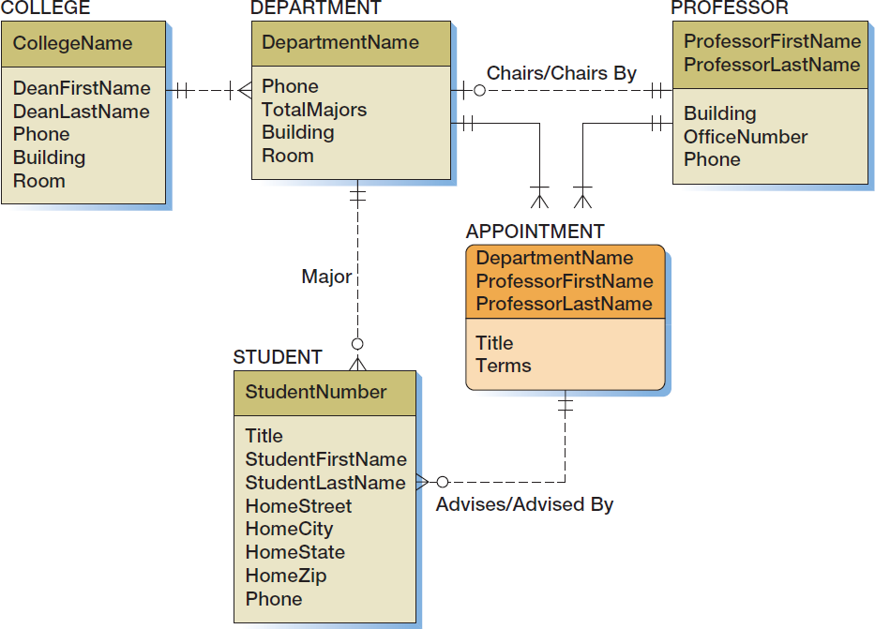
Highline University Data Model

Slide 53
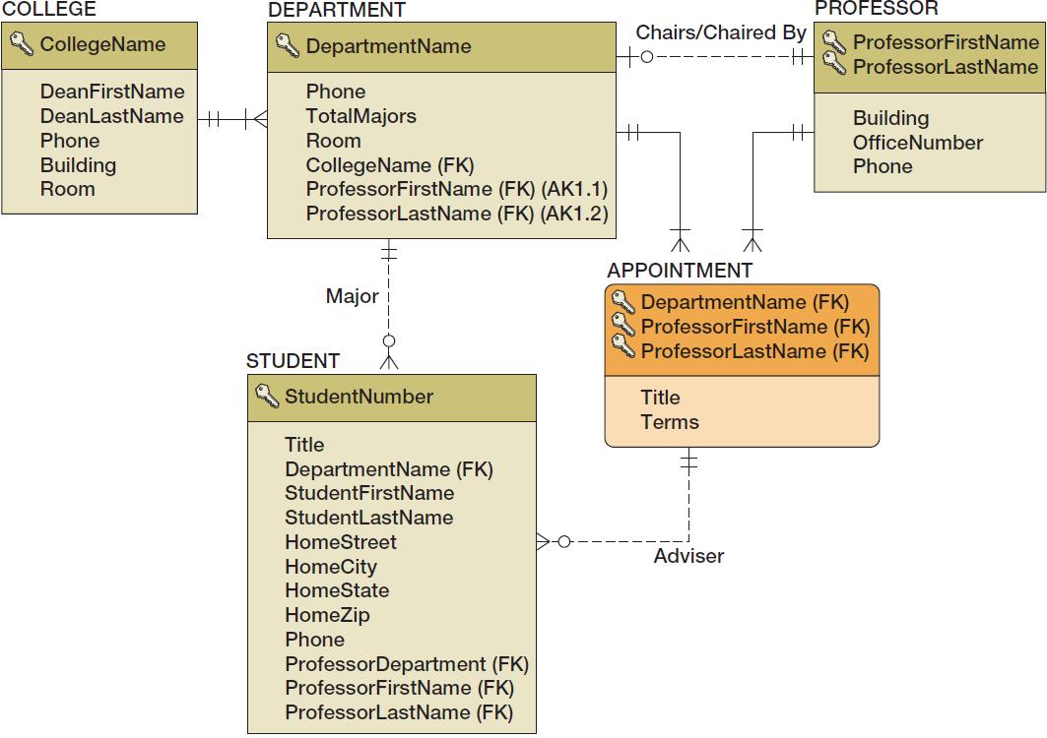
Highline University Database Design

Slide 54
Design for Minimum Cardinality
Relationships can have the following types of minimum cardinality:
O-O: parent optional and child optional
M-O: parent mandatory and child optional
O-M: parent optional and child mandatory
M-M: parent mandatory and child mandatory
We will use the term action to mean a minimum cardinality enforcement action.
No action needs to be taken for O-O relationships.

Slide 55
Cascading Updates and Deletes
A cascading update occurs when a change to the parent’s primary key is applied to the child’s foreign key.
Surrogate keys never change and there is no need for cascading updates when using them.
A cascading delete occurs when associated child rows are deleted along with the deletion of a parent row.
For strong entities, generally do not cascade deletes
For weak entities, generally do cascade deletes

Slide 56
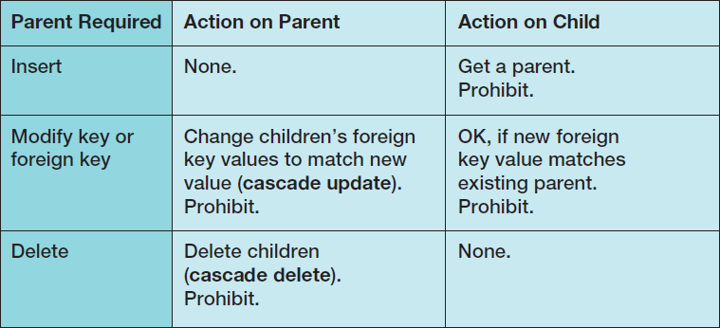
Actions When the Parent Is Required [Figure 6-29(a)]

Slide 57
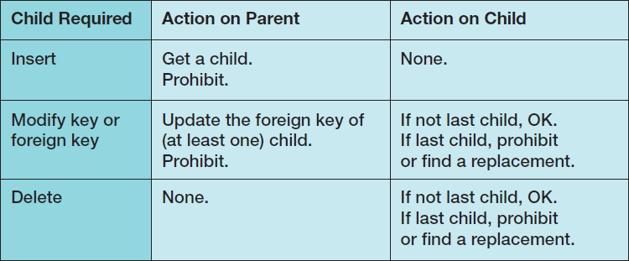
Actions When the Child Is Required [Figure 6-29(b)]

Slide 58
Application Programming: Triggers
Application programming uses SQL embedded in triggers, stored procedures, and other program code to accomplish a specific task.
A trigger is a stored program that is executed by the DBMS whenever a specified event occurs on a specified table or view (defined in Chapter Seven).
Triggers are used to enforce specific minimum cardinality enforcement actions not otherwise programmed into the DBMS.
Triggers will be discussed in detail in Chapters 7, 10A (Microsoft SQL Server 2014), 10B (Oracle Database),and 10C (MySQL 5.6).

Slide 59
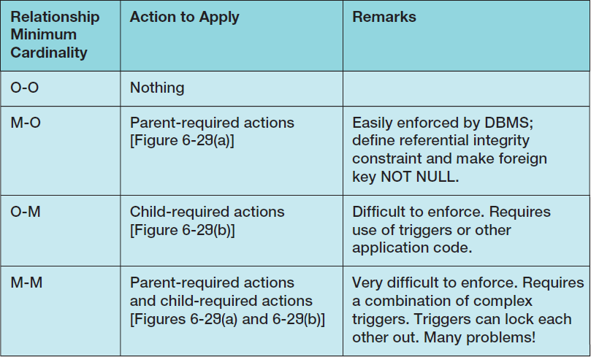
Actions To Apply to Enforce Minimum Cardinality

Slide 60
Implementing Actions for M-O Relationships
See Figure 6-29(a)
Make sure that:
Every child has a parent.
Operations never create orphans.
The DBMS will enforce the action as long as:
Referential integrity constraints are properly defined.
The foreign key column is NOT NULL.

Slide 61
Implementing Actions for O-M Relationships
See Figure 6-29(b)
The DBMS does not provide much help.
Triggers or other application codes will need to be written.

Slide 62
Implementing Actions for M-M Relationships
The worst of all possible worlds:
Especially in strong entity relationships.
In relationships between strong and weak entities the problem is often easier when all transactions are initiated from the strong entity side.
All actions in both Figure 6-29(a) and Figure 6-29(b) must be applied simultaneously.
Complicated and careful application programming will be needed.
Notes:
Because of the difficulty of enforcing M-M relationships, developers look for special circumstances to ease the task. Such circumstances usually exist for relationships between strong and weak entities, as described.
For relationships between strong entities, such special circumstances may not exist. In this case, the M-M cardinality is sometimes just ignored. Of course, this cannot be done for applications such as financial management or operations that require careful records management, but for an application such as airline reservations, where seats are overbooked anyway, it might be better to redefine the relationship as M-O.

Slide 63
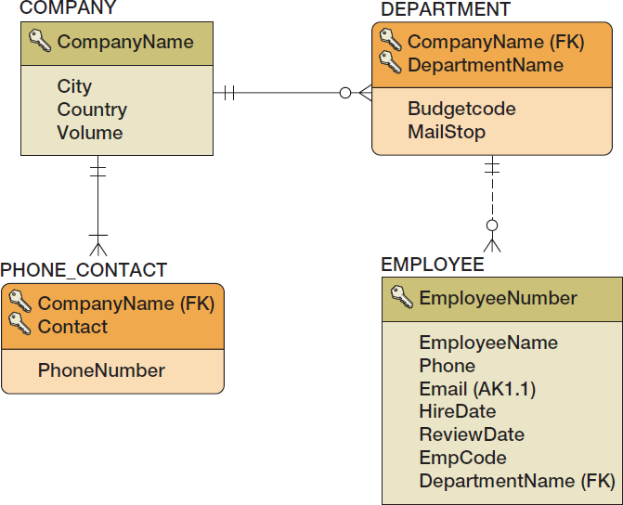
Implementing Actions for M-O Relationships: DEPARTMENT and EMPLOYEE I

Slide 64
Implementing Actions for M-O Relationships: DEPARTMENT and EMPLOYEE II
DEPARMENT is parent—EMPLOYEE is child.
Actions on parent:
DEPARTMENT rows can be created.
DEPARTMENT primary key—cascade updates if not surrogate key.
IF a DEPARTMENT is deleted, do we delete the associate EMPLOYEEs?
IF YES—cascade deletes.
IF NO—prohibit associate employees.

Slide 65
Implementing Actions for M-O Relationships: DEPARTMENT and EMPLOYEE III
Actions on child
Set referential integrity constraint and set foreign key to NOT NULL.
A new EMPLOYEE must have a valid DEPARTMENT or disallow the insert.
EMPLOYEEs can be reassigned to a different DEPARTMENT if a valid DEPARTMENT or disallow the update.
EMPLOYEEs can be deleted.

Slide 66
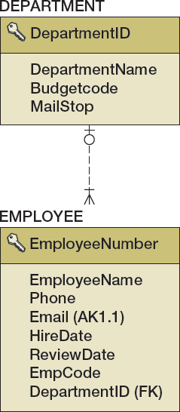
Implementing Actions for O-M Relationships: DEPARTMENT and EMPLOYEE I

Slide 67
Implementing Actions for O-M Relationships: DEPARTMENT and EMPLOYEE II
DEPARTMENT is parent—EMPLOYEE is child.
There must be at least one child row for each parent at all times.
Actions on parent:
DEPARTMENT rows can only be created when a relationship is created to a child row—REQUIRES A TRIGGER.
DEPARTMENT primary keys can only be updated if at least one EMPLOYEE foreign key is also updated —REQUIRES A TRIGGER.
Can a DEPARTMENT be deleted?
YES—it is the EMPLOYEE who is required.

Slide 68
Implementing Actions for O-M Relationships: DEPARTMENT and EMPLOYEE III
Actions on child
OK to insert a new EMPLOYEE.
There must be one EMPLOYEE for each department.
Cannot change EMPLOYEE foreign key (DEPARTMENT) if last EMPLOYEE in the DEPARTMENT.
Cannot delete an EMPLOYEE if last EMPLOYEE in the DEPARTMENT.

Slide 69
Implementing Actions for M-M Relationships: DEPARTMENT and EMPLOYEE
DEPARMENT is parent—EMPLOYEE is child.
All of the previous (M-O and O-M) apply at the same time!
This creates conflicts that require careful programming to avoid or fix problems such as:
A new DEPARTMENT insert will run a trigger that tries to create a new EMPLOYEE, but the EMPLOYEE row is checked by the DBMS for a valid DEPARTMENT before the transaction is completed.
If we try to delete a DEPARTMENT with any EMPLOYEEs we will find the trigger on EMPLOYEE delete will not let us delete the last EMPLOYEE, so we can’t delete the DEPARMENT.

Slide 70
Documenting the Minimum Cardinality Design: Documenting Required Parents
COMPANY is parent, DEPARTMENT is child.
The relationship is M-O.
This can often be done in the database design tools.

Slide 71
Documenting the Minimum Cardinality Design: Documenting Required Children
Needs written documentation
Can use Figure 6-29(b) as a “boilerplate document” and fill it out for each specific situation

Slide 72
Documenting the Minimum Cardinality Design: Documenting Required Children
DEPARTMENT is parent, EMPLOYEE is child.
The relationship is O-M.
Use documentation based on Figure 6-29(b)—see the next slide.

Slide 73
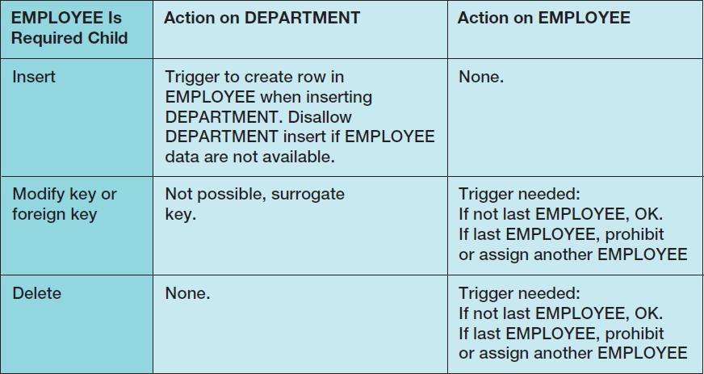
Documenting the Minimum Cardinality Design: Documenting Required Children

Slide 74
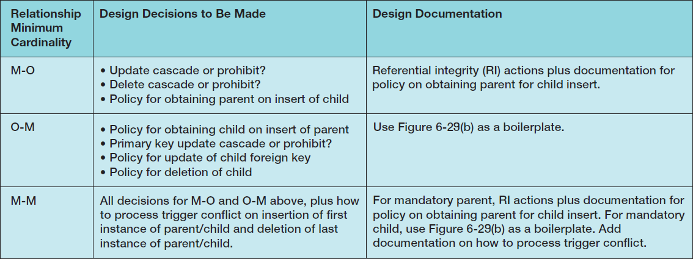
Summary of Minimum Cardinality Design

Slide 75

View Ridge Gallery

Slide 76
View Ridge Gallery
View Ridge Gallery is a small art gallery that has been in business for 30 years.
It sells contemporary European and North American fine art.
View Ridge has one owner, three salespeople, and two workers.
View Ridge owns all of the art that it sells; it holds no items on a consignment basis.
Notes:
The View Ridge Gallery (View Ridge or VRG) is a small art gallery that sells contemporary European and North American fine art, including lithographs, high-quality reproduction prints, original paintings and other artwork, and photographs. All of the lithographs, prints, and photos are signed and numbered, and the original art is usually signed. View Ridge also provides art framing services. It creates a custom frame for each artwork (rather than selling standardized, premade frames) and is known for its excellent collection of frame stock.
View Ridge emphasizes reproduction artworks of European Impressionist, Abstractionist, and Modernist artists such as Wassily Kandinsky and Henri Matisse. For original art, View Ridge concentrates on Northwest School artists, such as Mark Tobey, Morris Graves, Guy Anderson, and Paul Horiuchi, and produces shows of contemporary artists who work in the Northwest School tradition or in Northwest Maritime art. The price of new reproduction prints ranges up to $1,000, and prices for contemporary artists range from $500 to $10,000. The price of art from the Northwest School artists varies considerably, depending on the artwork itself. Small pencil, charcoal, or watercolor sketches may sell for as little as $2,000, whereas major works can range from $10,000 to $100,000. Very occasionally, View Ridge may carry Northwest School art priced up to $500,000, but art priced above $250,000 is more likely to be sold at auction by a major art auction house.

Slide 77

VRG Application Requirements

Slide 78

View Ridge Data Model

Slide 79

VRG Database Design I

Slide 80
VRG Database Design II
Surrogate keys are needed for:
CUSTOMER
WORK
TRANS
We can also use a surrogate key for ARTIST.
This will change the identifying relationships to nonidentifying relationships.
WORK and TRANS become weak, non-ID-dependent entities.
Foreign keys:
TRANS.CustomerID is NULL to allow acquisitions without an immediate sale to a CUSTOMER.
All other foreign keys are NOT NULL.

Slide 81

VRG Database Design III

Slide 82


Minimum Cardinality Enforcement: VRG Database Relationships

Slide 83

Minimum Cardinality Enforcement: VRG Database M-O Relationships ARTIST-to-WORK

Slide 84

Minimum Cardinality Enforcement: VRG Database M-O Relationships WORK-to-TRANS

Slide 85

Minimum Cardinality Enforcement: VRG Database M-O Relationships CUSTOMER-to-CUSTOMER_ARTIST_INT

Slide 86

Minimum Cardinality Enforcement: VRG Database M-O Relationships ARTIST-to-CUSTOMER_ARTIST_INT

Slide 87

Minimum Cardinality Enforcement: VRG Database M-M Relationship WORK-to-TRANS

Slide 88

VRG Database Table Designs: ARTIST

Slide 89

VRG Database Table Designs: WORK

Slide 90

VRG Database Table Designs: TRANS

Slide 91

VRG Database Table Designs: CUSTOMER

Slide 92

VRG Database Table Designs: CUSTOMER_ARTIST_INT

Slide 93

Summary of the Database Design Process

Slide 94
David Kroenke and David Auer Database Processing Fundamentals, Design, and Implementation (14th Edition)
End of Presentation:
Chapter Six

Slide 95

All rights reserved. No part of this publication may be reproduced, stored in a retrieval system, or transmitted, in any form or by any means, electronic, mechanical, photocopying, recording, or otherwise, without the prior written permission of the publisher. Printed in the United States of America.

